Slide 1
Confidentiality, Integrity & Authentication
Confidentiality - Symmetric Key Encryption
Data Integrity – MD-5, SHA and HMAC
Public/Private Key mechanism - RSA
Digital Certificate
DH algorithm
CN8816: Network Security

Slide 2
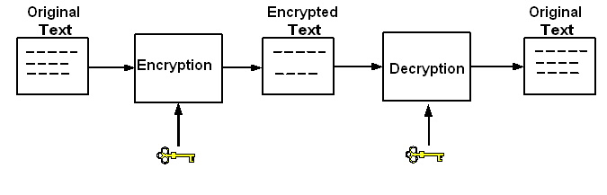
1. Symmetric Key Algorithm
Encryption
  Confidentiality - Keeping information out of the hands of unauthorized users
  Technique: Data Encryption
Confidentiality, Integrity and Authentication
CN8816: Network Security

Slide 3
1. Symmetric Key Algorithm
Symmetric Key encryption
  encryption and decryption use the same key
  Data Encryption Standard (DES) - 1977
  Advanced Encryption Standard (AES) - 2001
Plain Text
P
Encryption
Cipertext
C
Decryption
Plain Text
P
Ks
Ks
Same key
Confidentiality, Integrity and Authentication
CN8816: Network Security

Slide 4
1. Symmetric Key Algorithm
Electronic Codebook (ECB) Mode
  The plain text is divided into a number blocks with fixed size
    DES – block size = 64 bits
    AES – block size = 128 bits
  Each block is encrypted and decrypted independently
Plain text with padding
…
…
B1 Bn BN
Ks
En
Ks
En
Ks
En
…
…
C1
Cn
CN
Confidentiality, Integrity and Authentication
CN8816: Network Security

Slide 5
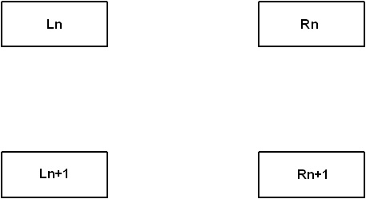
1. Symmetric Key Algorithm
DES Algorithm
  Data is divided into 64-bit blocks
  Basic operation:
K_{N+1}
+
F( )
Confidentiality, Integrity and Authentication
CN8816: Network Security

Slide 6
1. Symmetric Key Algorithm
  Both encryption and decryption processes consist of 16 rounds of basic operation
    Encryption and decryption have the same structure
Key
Permutation
Input
Key expansion
k1/k16
Basic Operation 1
…
…
k16/k1
Basic Operation 16
Left
Right
Inverse Permutation
Output
Confidentiality, Integrity and Authentication
CN8816: Network Security

Slide 7
1. Symmetric Key Algorithm
DES3
  Cascading three DES blocks to support a longer key length
  Supports key lengths of 56, 112, and 168
key1
key2
key3
plaintext
DES
Encryp.
DES
Decryp.
DES
Encryp.
ciphertext
Confidentiality, Integrity and Authentication
CN8816: Network Security

Slide 8
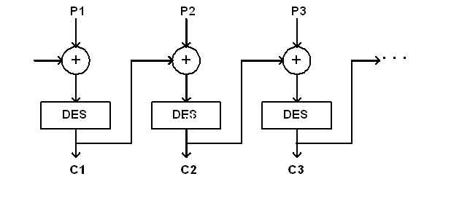
1. Symmetric Key Algorithm
Cipher block chaining (CBC) mode
Initial Vector
(IV)
Confidentiality, Integrity and Authentication
CN8816: Network Security

Slide 9
1. Symmetric Key Algorithm
AES
  Use the concept of multiplicative inversion
    P(x)*P⁻¹(x) = 1
    Basic 8-bit multiplication operation:
      ( P(x) * Q(x) ) mod ( x⁸+x⁴+x³+x+1)
      x⁸+x⁴+x³+x+1 is an irreducible polynomial
      With the defined multiplication operation, all the 8-bit numbers, except zero, have their own inverses
      Example: the inverse of x⁷+x³+x²+1 is x, for
      (x⁷+x³+x²+1)*x mod ( x⁸+x⁴+x³+x+1) = 1
Confidentiality, Integrity and Authentication
CN8816: Network Security

Slide 10
1. Symmetric Key Algorithm
  AES consists of N rounds of basic operation
    N= 10, 12, or 14 for the key size of 128, 192, or 256, respectively
k0
+
Key expansion
Input
k1
Basic Operation 1
Key
…
…
K(N-1)
Basic Operation N-1
KN
Sub-byte and shift row
Output
Confidentiality, Integrity and Authentication
CN8816: Network Security

Slide 11
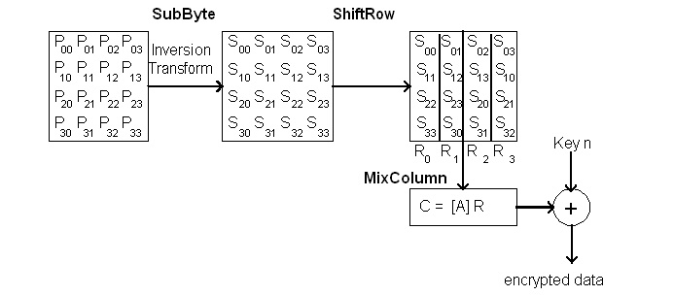
1. Symmetric Key Algorithm
AES
  Basic operation
Confidentiality, Integrity and Authentication
CN8816: Network Security

Slide 12
1. Symmetric Key Algorithm
  SubByte Processing
    From P_{i,j} , find Inv(P_{i,j})
      P_{i,j} Inv(P_{i,j} ) Mod (x⁸+x⁴+x³+x+1) = 1
    Inv(P_{i,j}) is then multiplied with a fixed 8x8 binary matrix and then added with a fixed binary vector
S_{i,j} = B₁ Inv(P_{i,j}) + B₂
c₀ 1 0 0 0 1 1 1 1 b₀ 1
c₁ 1 1 0 0 0 1 1 1 b₁ 1
c₂ 1 1 1 0 0 0 1 1 b₂ 0
c₃ 1 1 1 1 0 0 0 1 b₃ 0
c₄ 1 1 1 1 1 0 0 0 b₄ 0
c₅ 0 1 1 1 1 1 0 0 b₅ 1
c₆ 0 0 1 1 1 1 1 0 b₆ 1
c₇ 0 0 0 1 1 1 1 1 b₇ 0
=
+
Confidentiality, Integrity and Authentication
CN8816: Network Security

Slide 13
1. Symmetric Key Algorithm
  ShiftRow
R₀
R₁
R₂
R₃
S_{0,0} S_{0,1} S_{0,2} S_{0,3}
S_{1,0} S_{1,1} S_{1,2} S_{1,3}
S_{2,0} S_{2,1} S_{2,2} S_{2,3}
S_{3,0} S_{3,1} S_{3,2} S_{3,3}
S_{0,0} S_{0,1} S_{0,2} S_{0,3}
S_{1,1} S_{1,2} S_{1,3} S_{1,0}
S_{2,2} S_{2,3} S_{2,0} S_{2,1}
S_{3,3} S_{3,0} S_{3,1} S_{3,2}
R₀ (x) = S_{3,3} x³ + S_{2,2} x² + S_{1,1} x + S_{0,0}
R₁ (x) = S_{3,0} x³ + S_{2,3} x² + S_{1,2} x + S_{0,1}
R₂ (x) = S_{3,1} x³ + S_{2,0} x² + S_{1,3} x + S_{0,2}
R₃ (x) = S_{3,2} x³ + S_{2,1} x² + S_{1,0} x + S_{0,3}
Confidentiality, Integrity and Authentication
CN8816: Network Security

Slide 14
1. Symmetric Key Algorithm
  MaxColumns transform
    Z_{i} = a(x) × R_{i}(x) (mod) x⁴ + 1
      a(x) = {03}x³ + {01}x² + {01}x + {02}
    Z_{i} = A R_{i}
      A =
    The product of the multiplication of the two coefficients is still limited to the finite field of 8 bits
      Applying modular operation with the modulus of
        x⁸ + x⁴ + x³ + x + 1
02 03 01 01
01 02 03 01
01 01 02 03
03 01 01 02
Confidentiality, Integrity and Authentication
CN8816: Network Security

Slide 15
1. Symmetric Key Algorithm
  AddRoundKey Transformation
Round Key
Z_{0,0} Z_{0,1} Z_{0,2} Z_{0,3}
Z_{1,0} Z_{1,1} Z_{1,2} Z_{1,3}
Z_{2,0} Z_{2,1} Z_{2,2} Z_{2,3}
Z_{3,0} Z_{3,1} Z_{3,2} Z_{3,3}
K_{0,0} K_{0,1} K_{0,2} K_{0,3}
K_{1,0} K_{1,1} K_{1,2} K_{1,3}
K_{2,0} K_{2,1} K_{2,2} K_{2,3}
K_{3,0} K_{3,1} K_{3,2} K_{3,3}
Xor
E_{0,0} E_{0,1} E_{0,2} E_{0,3}
E_{1,0} E_{1,1} E_{1,2} E_{1,3}
E_{2,0} E_{2,1} E_{2,2} E_{2,3}
E_{3,0} E_{3,1} E_{3,2} E_{3,3}
Encrypted output
Confidentiality, Integrity and Authentication
CN8816: Network Security

Slide 16
2. Data Integrity
Message Digest
  The digest is the hash function of a message
  A small change of the message will completely change the hash value
Data: 1001011010… Hash 01101110
    Data: 1001010010… Hash 11011001
Confidentiality, Integrity and Authentication
CN8816: Network Security

Slide 17
2. Data Integrity
Hash algorithms
  MD-5: 512-bit block, 128-bit hash
  Secure Hash Algorithm (SHA)
    SHA-1: 512-bit block, 160-bit hash
    SHA-224: 512-bit block, 224-bit hash
    SHA-256: 512-bit block, 256-bit hash
    SHA-384: 1024-bit block, 385-bit hash
    SHA-512: 1024-bit block, 512-bit hash
Confidentiality, Integrity and Authentication
CN8816: Network Security

Slide 18
2. Data Integrity
SHA-512
  Message Padding
    The padding includes the padding and length fields
      The length field holds the value of the message length
      The padding field contains the bit pattern 100…00
Padding
128
Message 100…00 Length
Integer multiple of 1024-bit blocks
Confidentiality, Integrity and Authentication
CN8816: Network Security

Slide 19
2. Data Integrity
  Processing overview
M₁ M₂ … M_{i} … M_{N}
Expansion
Expansion
Expansion
Expansion
W₀…W₇₉
W₀…W₇₉
W₀…W₇₉
W₀…W₇₉
a=H₀(0)
…
h=H₇(0)
Hashing
Hashing
Hashing
Hashing
HASH
H₀(N)|| … ||H₇(N)
a=H₀(1)
…
h=H₇(1)
a=H₀(i-1)
…
h=H₇(i-1)
a=H₀(N-1)
…
h=H₇(N-1)
Confidentiality, Integrity and Authentication
CN8816: Network Security

Slide 20
2. Data Integrity
Keyed Hashing for Message Authentication (HMAC)
  Provides data integrity between two security entities sharing the secret key
  Keyed hash = Hash(K+opad, Hash(K+ipad, text))
    K = Concatenation(Key, (M-Key_size) of zeros)
    ipad = 00110110 (Ox36) repeated M times
    opad = 01011100 (Ox5C) repeated M times
    M = Hash function message block size (in bytes)
  The hash function can be either MD5 or SHA
Confidentiality, Integrity and Authentication
CN8816: Network Security

Slide 21
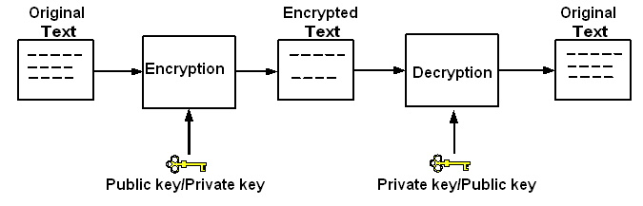
3. Private/Public Key Mechanism
Public/Private Key – RSA and ECC (Elliptic Curve Cryptography)
  Consists of a private key and a public key pair
    Public key can be known by the public
Confidentiality, Integrity and Authentication
CN8816: Network Security

Slide 22
3. Private/Public Key Mechanism
RSA algorithm:
  Select two large prime numbers, P and Q
  Select an odd number E such that E and (P-1)(Q-1) are relative prime
  Find a number D, which is the multiplicative inverse of E, such that
    DE modulo (P-1)(Q-1) = 1
    Public key = (E, PQ)
    Private key = (D, PQ)
  Encrytion/Decryption:
    Cipher Text (C) = ME mod PQ
    Origin Text (M) = C^{D} mod PQ = M^{ED} mod PQ
Confidentiality, Integrity and Authentication
CN8816: Network Security

Slide 23
3. Private/Public Key Mechanism
RSAES-OAEP algorithm
  Provides integrity check to counter the chosen cipher attack
L
Hash
hash padding Ox01 secret
seed
MGF
O
+
O
Public_key
+
MGF
Ox00 masked seed Masked Data Block
Encryption
cipher
text
Confidentiality, Integrity and Authentication
CN8816: Network Security

Slide 24
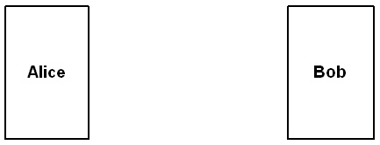
3. Private/Public Key Mechanism
Session Key Encryption Application
  Second message authenticates Bob
  Third message authenticates Alice
1. Eb(A, Na)
2. Ea(Na, Nb, Ks)
3. Ks(Nb)
Data encrypted with Ks
Eb = encryption using Bob’s public key
Ea = encryption using Alice’s public key
Ks = session key
Confidentiality, Integrity and Authentication
CN8816: Network Security

Slide 25
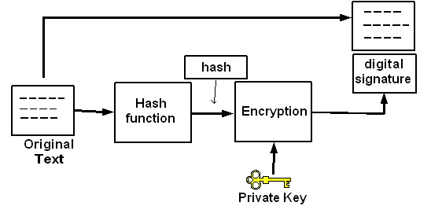
3. Private/Public Key Mechanism
Digital Signature Application
  Private/public key pair and hash function
Confidentiality, Integrity and Authentication
CN8816: Network Security

Slide 26
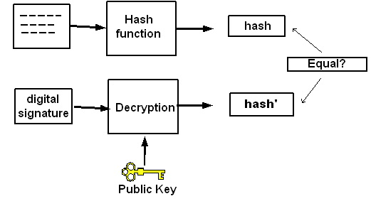
3. Private/Public Key Mechanism
  A public key is used to verify the digital signature
Confidentiality, Integrity and Authentication
CN8816: Network Security

Slide 27
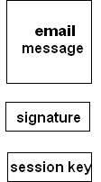
3. Private/Public Key Mechanism
Example: PGP (Pretty Good Privacy)
6. verify the signature using the sender’s public key
1. signed with the sender’s private key
5. decrypted with the session key
2. encrypted with the session key
3. encrypted with the recipient’s public key
4. decrypted with the recipient’s private key
Confidentiality, Integrity and Authentication
CN8816: Network Security

Slide 28


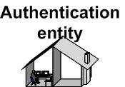
4. Digital Certificate
Digital Certificate provides a more scalable authentication approach
  The certificate is issued and signed by the certificate authority (CA)
1. Certificate request
2. Certificate
Certificate
Verification of the certificate
Confidentiality, Integrity and Authentication
CN8816: Network Security

Slide 29
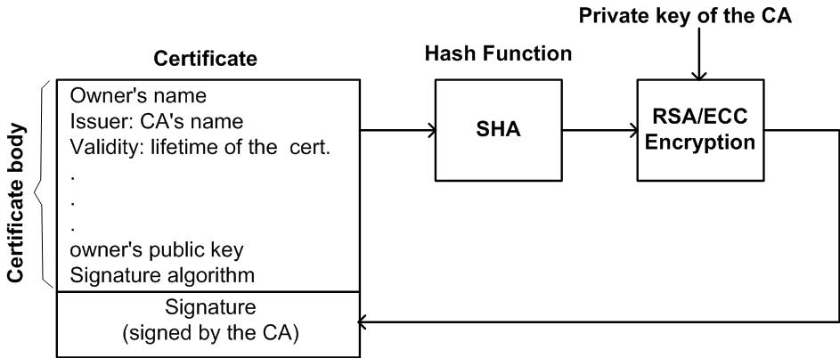
4. Digital Certificate
Signing of the certificate
Confidentiality, Integrity and Authentication
CN8816: Network Security

Slide 30
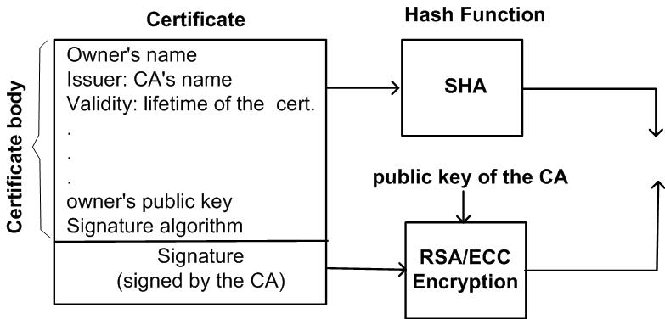
4. Digital Certificate
Verification of the certificate
Equal?
Confidentiality, Integrity and Authentication
CN8816: Network Security

Slide 31
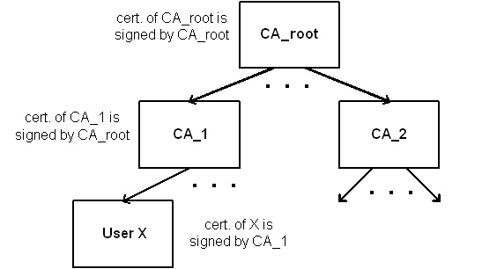
4. Digital Certificate
  CA Hierarchical structure
    the root CA delegates the certification authority to the intermediate CA
Confidentiality, Integrity and Authentication
CN8816: Network Security

Slide 32

4. Digital Certificate
Public Key Infrastructure (PKI)
  To enable secure, convenient, and efficient acquisition of public keys using digital certificate
  PKI architecture model:
User
Cert/CRL retrieval
End entity
Cert pub.
registration
revocation
Regist. Auth.
Cert/CRL pub.
CA
CRL pub.
CRL issuer
cross
certification
Management
CA
Confidentiality, Integrity and Authentication
CN8816: Network Security

Slide 33
5. DH Algorithm
Diffie-Hellman Key Exchange
  Used to generate a common secret (symmetric) key
Alice generates a large random number x
Bob generates a large random number y
g^{x} mod n
g^{y} mod n
key = g^{xy} mod n
Confidentiality, Integrity and Authentication
CN8816: Network Security

Slide 34
5. DH Algorithm
  DH exchange is susceptible to the man-in-the-middle attack
    Peers must require authentication
gª mod n
g^{a’} mod n
Alice
Trudy
Bob
g^{b} mod n
g^{b’} mod n
g^{ab’} mod n
g^{ab’} mod n
g^{a’b} mod n
g^{a’b} mod n
Trudy can intercept the messages exchanged between Alice and Bob
Confidentiality, Integrity and Authentication
CN8816: Network Security

